Slide 1
Icelandic Research Fund 2015

Slide 2
The Icelandic Research Fund
The role of the Icelandic Research Fund (IRF) is to enhance scientific research and research education in Iceland.
For this purpose the IRF awards funding to research students and defined research projects led by individuals, research teams, universities, research institutes, and companies (cf. Act 3/2003 with later amendments).

Slide 3
Eligibility
Principal investigators must have completed graduate studies at a an internationally accredited university and have experience in running research projects.
Doctoral students apply with their supervisor who is the principal investigator of the project.
The same individual may apply for any number of grants as a principal investigator.
Only one type of grant proposal can be submitted for the same research project.

Slide 4
General requirements for all grant types
The project shall have clear objectives, research plan and well-defined milestones.
It should be stated who will carry out each part of the project.
A detailed budget and cost justification is required, clearly explaining all parts of the project, their individual cost and financing.
The proposal shall clearly describe the proposed deliverables and impact of the project.

Slide 5
Grants of excellence
Grants warded to large scale projects with the aim to carry Icelandic research to the international forefront.
For research groups and thus, co-proposers are required in addition to the PI.
The PI shall be a scientist with a recognized track record, leadership qualities and experience in running research projects.
A contribution of graduate students.
Co-operation with foreign researchers.

Slide 6
Postdoctoral fellowships
Are available to young scientists having received their Ph.D. degree within 5 years from the start of the project.
Have to have a host institution (letter of intent).
The grant provided by the IRF amounts to a total of 100% of the total project cost.
In addition to general requirements the proposer shall explain how the fellowship fits with previous work, how it will enhance his/her career development and as well as inform about the proposer´s future research plans.

Slide 7
Doctoral students
No specific application forms are available for doctoral students but funding for doctoral students can be applied for on the forms for project grants and grants of excellence
A PI includes salaries for a PhD student without a specific person in mind. If the PI gets funded the PhD position can be advertised.
A PI includes salaries for a specific PhD student. In this case the student writes a LOI stating his/her future plans and how the project fits therein.

Slide 8
Grant size
Grant type | Max for 1 year (MISK) | Max for 2 years (MISK) | Max for 3 years (MISK) | IRF % | Over-head
Grant of excellence | 35 | 70 | 105 | 85% | 20%
Project grant | 10 | 20 | 30 | 85% | 20%
Postdoctoral fellowship | 7 | 14 | 21 | 100% | 20%

Slide 9
Eligible cost
Salaries and related cost
Operational expenses
Travel expenses
Contracted services
Dissemination cost
max 500 thousand, the final year of the project
Overhead and facilities
20% of all cost applied for, except for contracted services.
All cost must be justified and explained in detail

Slide 10
Salaries incl. related expenses
Level | Max. per month (ISK) | Max. number of months per person
Senior personnel 1 (e.g. Full professor) | 670.000 | 36
Senior personnel 2 (e.g. Associate or assistant professor) | 550.000 | 36
Postdoctoral researcher | 480.000 | 36
Doctoral student Researcher | 350.000 | 36
Master's degree student | 300.000 | 12

Slide 11
Proposal forms and appendices
All proposal forms and appendices must be in English
Access to electronic submission system
Specific forms for:
Project description
CV
No specific forms for:
Letters of intent from „other participants“ (GoE and PG), host institution (Postdoctoral fellowship grants), and doctoral students
Price quotes

Slide 12
Project description:
Objectives of the project and originality
State of the art and proficiency
Methodology, work plan and timescale
Milestones and deliverables
Co-operation (domestic/foreign)
Contribution of doctoral and master's degree students to the project (if appl.)
Impact
Proposed publication of results
Career development plan (specific for Postdoctoral Fellowship proposals)

Slide 13
Deliverables The deliverables of the projects would be measurable “units” resulting from the project, including:
Published scientific
articles
Publications
University diplomas
Software
Databases
Production methods
New products
Patents
Models
Research methods
Confirmed scientific
theories

Slide 14
Rejection of proposals
Incomplete proposals will be rejected.
Proposers should under no circumstances contact either Board members or expert panel members with matters regarding proposals under review. Any issues regarding proposals under review are handled by RANNÍS. Failure to comply with these requirements leads to rejection.
Ethical issues (plagiarism, fabrication, falsification etc.) may lead to rejection.
No documents or information regarding the proposal will be accepted after the deadline.

Slide 15
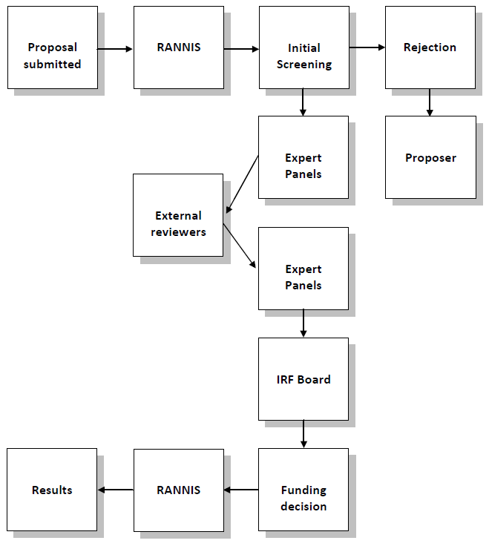
Evaluation process

Slide 16
Expert panels
Engineering, technical sciences and physical sciences
Natural science and environmental science
Health science and life sciences
Social sciences and public health
Humanities

Slide 17
Expert panels
Appointed by the Science committee of the Science and technology policy council.
Serve for 2 years.
Each panel has a maximum number of 7 panelists. At least two members are from abroad.
Two external (outside of Iceland) experts review each proposal.
The expert panel reviews all the proposals, establishes a ranking list based on the expert evaluations, and finalizes each proposal with a written report.
The expert panels are responsible for evaluation and ranking of proposals. External reviews are for guidance to the expert panel.

Slide 18
Appraisal of proposals
Expert panels consider the following in the appraisal:
The scientific value of the project
Principal Investigator‘s qualification to perform the research project
Facilities
Propabilities that the project will lead to publications of results or a patent of intellectual property rights

Slide 19
Ranking of proposals
A. High Impact – Recommended for funding
A.1) Exceptionally strong with essentially no weaknesses (5%)
A.2) Extremely strong with negligible weaknesses (10%)
A.3) Very strong with only some minor weaknesses
A.4) Strong but with numerous minor weaknesses
B. Moderate Impact – Only for further consideration if funds are available. Some strengths but with at least one moderate weakness
C. Low Impact – Not recommended for further consideration. A few strengths and at least one major weakness

Slide 20
The Science Committee emphasizes that in the review of proposals the following points should carry weight:
Research projects should be supported according to their merit based on scientific value, the qualifications of the applicants and research facilities and the probability that the project will produce measurable results and benefits.
Projects which meet quality criteria and are carried out in an active, professional and financial co-operation of companies, universities and institutions should, other things being equal, be given priority for grants from competition funds.
Results, which are financed by grants from the IRF, should be made public and made available to everybody unless otherwise agreed.
The allocation of grants from the IRF should be decided on the basis of the total cost of the project.
The IRF should take into account the circumstances of the applicants, e.g. independently working researchers, researchers working within universities, research institutions or companies.
There should be a focus on gender balance and young scientists.

Slide 21
Members of the IRF Board 2012 - 2014
Members
Dr. Guðrún Nordal, The Árni Magnússon Institute, chair
M.Sc. Freygarður Þorsteinsson, Össur
Dr. Jón Gunnar Bernburg, University of Iceland
Dr. Unnur Þorsteinsdóttir, deCODE genetics
Dr. Þorsteinn Þorsteinsson, Icelandic Meteorological Office
Vice
Dr. Már Jónsson, University of Iceland
Dr. Fjóla Jónsdóttir, University of Iceland
Dr. Þóroddur Bjarnason, University of Akureyri
Dr. Unnur Styrkársdóttir, deCODE genetics
Dr. Þóra Ellen Þórhallsdóttir, University of Iceland

Slide 22
Thank you

